Slide 1
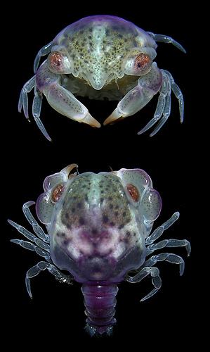
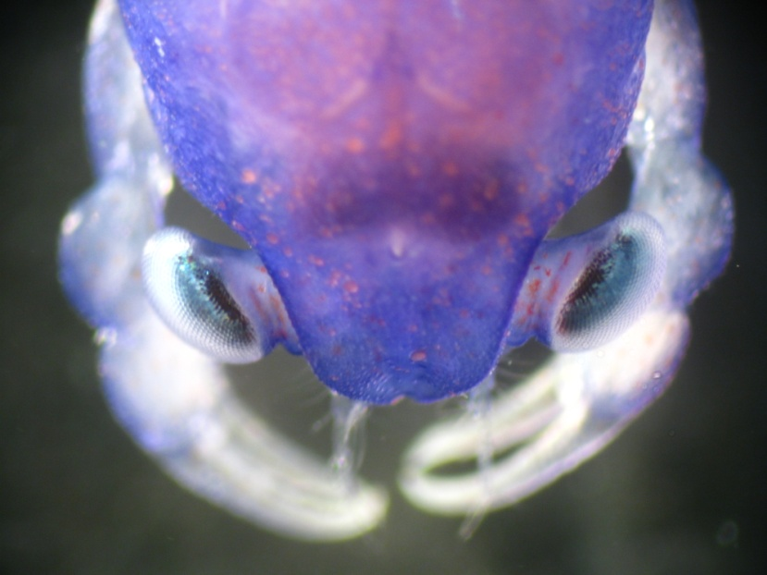
Location, location, location – finding a suitable home in amongst the noise
Jenni Stanley, Craig Radford
& Andrew Jeffs
Post-doctoral Fellow

Slide 2
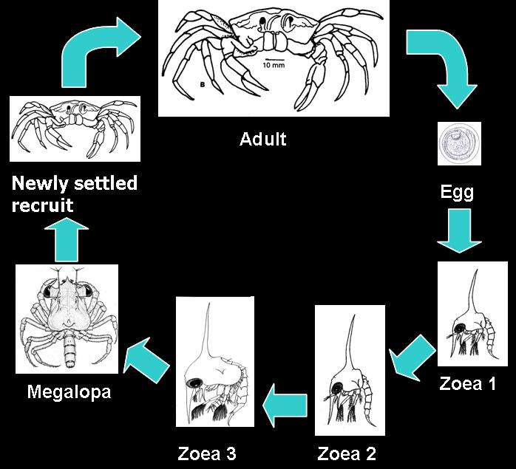
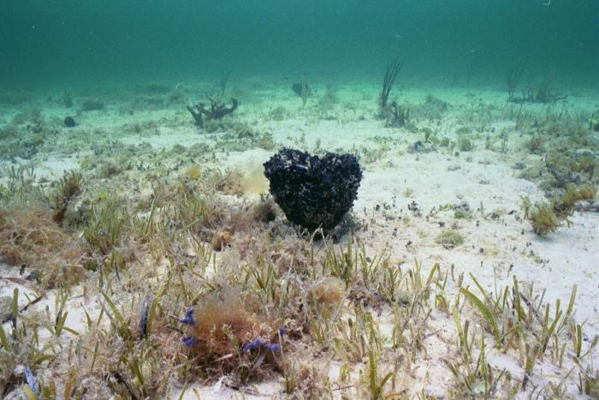
Background
Final stage of larval development in benthic marine organisms involves selecting a suitable settlement habitat.
Involves specific cue or combination of cues
    Physical
    Chemical
Can be both general and species specific
Notes:
- The final stage of larval development in benthic marine organisms involves selecting a suitable habitat in which to settle.
The process of settlement and metamorphosis often involves a specific cue or a combination of physical and/or chemical cues, which reliably identifies a suitable settlement habitat.
- These cues can be both general and apply to many species, such as the chemical cues associated with conspecifics, and species specific, such as the presence of macroalgae species for the blue crab

Slide 3
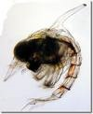
Settlement and Metamorphosis
Not the same process
Tightly coupled in biofouling organisms
Capability of “delaying metamorphosis” in some species
Ecological costs because it extends time in the plankton
Physiological costs as it reduces post-metamorphic growth rate
Notes:
- Not the same process
However in many biofouling organisms it is tightly coupled and hard to distinguish between the two
In other species they are not so coupled and the organism does not progress into metamorphosis if stimulatory cues are absent.
They may return to the plankton and repeat the process of locating and selecting a suitable habitat.
this process is often referred to as “delayed metamorphosis” – where the larvae are competent to settle but due to the absence of cues do not
A delay in metamorphosis is thought to in some spp have ecological costs as it extends time in the plankton – known to be a vulnerable period
and also physiological costs as it has been found to reduce the growth rate in post-metamorphic juveniles and reduce the fitness of their offspring

Slide 4
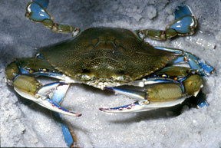


Crab Settlement Studies
Most crab studies that have occurred in the last decade
    Blue crab (Callinectes sapidus)
    Common mud crab (Panopeus herbstii)
    Fiddler crab (Uca pugnax)
    Estuarine mud crab (Rhithropanopeus harrisii)
Focus on cues that shorten or lengthen time to metamorphosis (TTM)
In brachyuran crabs TTM can be shortened by 15 – 25% with exposure to chemical cues (Forward Jr. et al., 2001)
Notes:
Most studies on settlement in Brachyuran crabs that have occurred within the last decade focus on identifying cues that shorter or lengthen TTM in these common species
These studies have found that TTM can often be shortened by 15 – 25% upon exposure to chemical cues which can be sourced from:
The presence of adults, aquatic vege, biofilms, conspecifics, related crabs species and potential prey

Slide 5
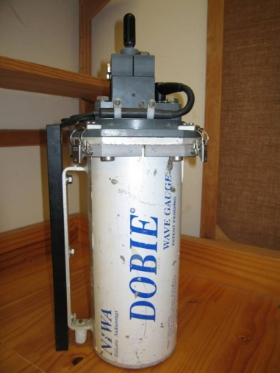
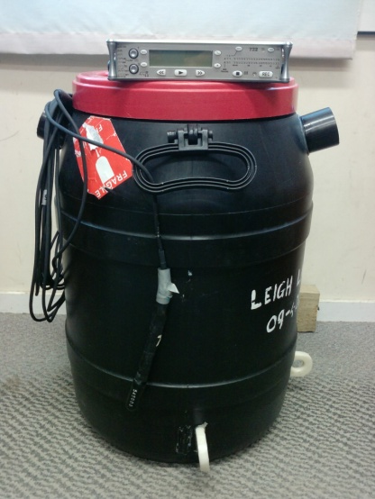
Ambient Underwater Sound
Composed of a wide range of frequencies
    Abiotic 50 – 1000 Hz – wind and waves
    Biotic 50 – 50,000 Hz – biological
    Anthropogenic – infrasound to ultrasound – human activities
The major component of the sound emitted from a reef is produced by the inhabitants
A cue which communicates a lot of habitat information would be of great value to larval settlers
Notes:
Here is where my work comes in
Ambient underwater sound is composed of a wide range of frequencies
Abiotic sources are usually produced by the effect of the wind and the waves and typically produce sound in the frequency band of 50 – 1000 Hz.
Biotic sounds are produced by a range of activities by marine life including communication, repro displays, territory defence, feeding and echolocation. These sounds can cover a very large frequency range of about 50 – 50,000 Hz.
Anthropogenic sounds are also present and are produced by a range of human activities that range from infrasound to ultrasound.
reefs are a major source of sound in the ocean and typically the major component of reef sound is produced by the animals inhabiting it
For these reasons it is logical to expect that differences in the presence and abundance of resident animals will result in different coastal habitats generating different underwater sounds.
An acoustic cues that conveys both directional and habitat type and quality information would be of high value to larval stages of coastal organisms attempting to remotely locate a suitable settlement habitat.

Slide 6
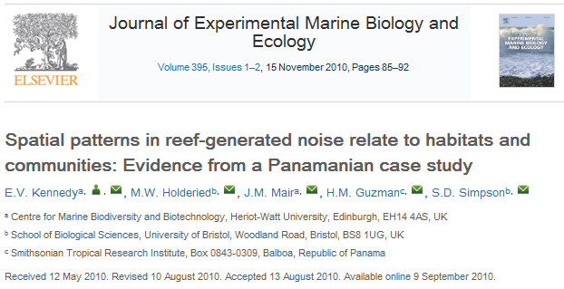
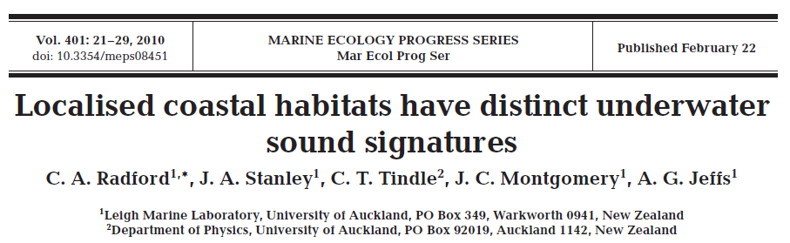
Unique Habitat Signatures
Significant differences in ambient sound associated with different coastal habitats in subtropical New Zealand
Differences in acoustic profiles due to fish communities and benthic characteristics.
Notes:
In the past there have been two published studies which have broadly examined differences in the underwater acoustic environment in shallow coastal waters in typical temperate and tropical reefs
One of these provided evidence that there are significant differences in the spectral and temporal composition of ambient sound associated with different coastal habitat types over relatively small spatial scales in subtropical far north of New Zealand.
CLICK
The other enabled some broad inferences to be made from daytime point sampling of the acoustic profiles of reefs in relation to the fish communities and benthic characteristics.
However both of these past studies had limited temporal sampling of underwater sound

Slide 7
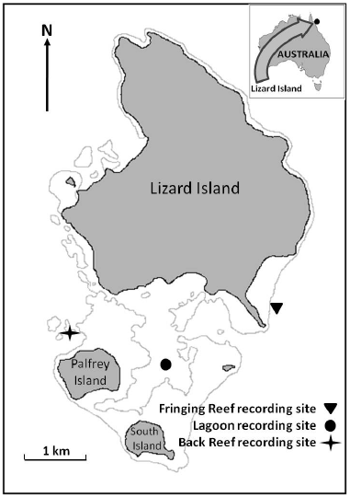
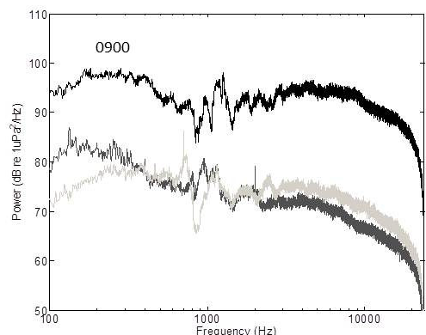
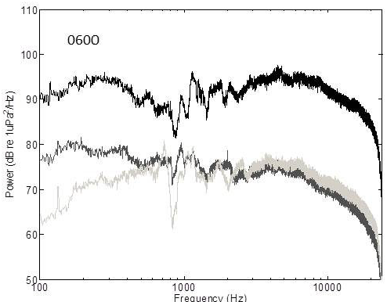
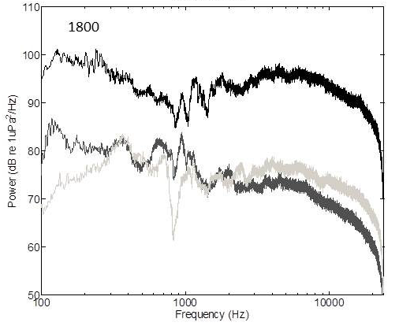
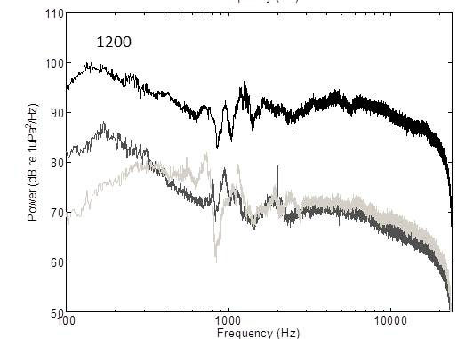
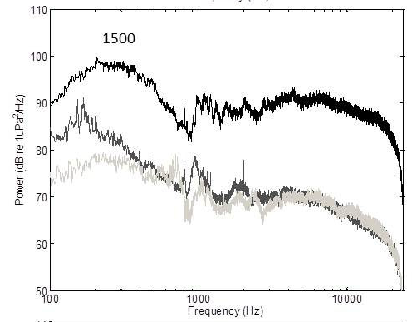
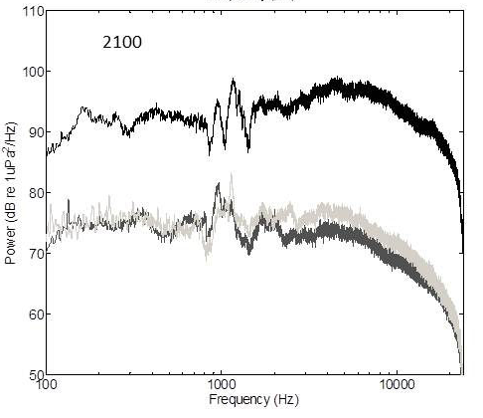
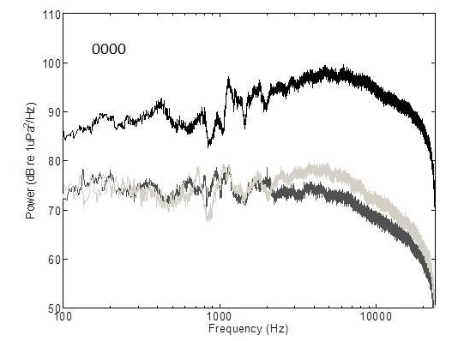
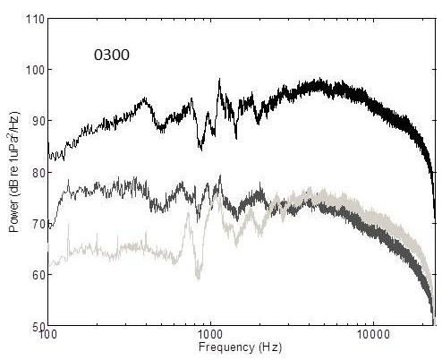
Unique Habitat Signatures
1800
2100
0900
1500
0600
1200
0300
0000
1500
Fringing Reef
Lagoon
Back Reef
Notes:
Therefore, we recorded the underwater sound emitted from three adjacent habitats (fringing reef, back reef and lagoon) at Lizard Island on the Great Barrier Reef, Australia. These recordings were taken at regular hourly intervals over a 24 hour period during the new moon in early summer.
CLICK
Analyses of the sound recordings revealed marked differences among the habitats in frequency and temporal composition.
Overall, the sound from fringing reef habitat was significantly louder than the other two habitats throughout the 24 hour period.
Most of the spectral variability among the three habitats was observed below 1000 Hz, where the spectral levels peaked at different times of the day within the different habitats.
All three habitats exhibited a marked nocturnal increase in spectral levels in the frequency band 2501-22000 Hz starting at dusk (1800 hrs) and declining at dawn (0600 hrs).

Slide 8
Unique Habitat Signatures
Fringing Reef
Back Reef
Percentage Prms²
Time
Lagoon
Notes:
There was also significant diurnal trends the proportion of total sound intensity for site,
Overall the majority of the sound energy at each site was in the 2501 – 22000 Hz freq band – acoustic range of snapping shrimp.
Fringing reef and back reef had similar diurnal trends in Prms, where the proportion of total sound intensity 2501 – 22000 Hz freqy band was around 90% during the night time hours and decreasing to around 70 – 80% during daylight hours.
The energy in this frequ band was significantly less in the lagoon habitat with approximately 70% prms during the night and decreasing to 50% during the day.
CLICK
The proportion of sound energy in the 1001 – 2500 Hz freq band was relative constant throughout the day for all three sites.
CLICK
The majority of the variation among habitats was in the lower freq band of 100 – 1000 Hz which is the freq range where most fish vocalisations occur.
All sites had a significant rise in prms during the daylight hours. The lagoon habitat peaked at the highest proportion followed by fringing reef and back reef, all at different times of the day.

Slide 9
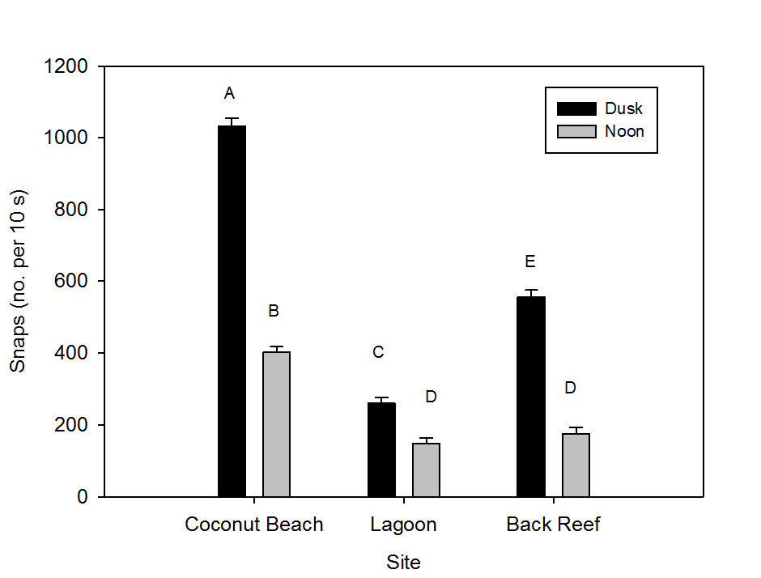
Unique Habitat Signatures
Fringing Reef
Lagoon
Back Reef
Notes:
Number of snaps produced by snapping shrimp exhibited significant differences for site, time of day and the interaction site x time of day
There were significantly more snaps during the dusk period compared to during the noon period at all sites.
Overall the fringing reef site had significantly more snaps produced during both dusk and noon periods compared to the back reef and lagoon sites
Both the back reef and lagoon sites had a similar number of snaps produced during the noon period.
The acoustic variation seen at these habitats appears to be due in a large part to differences in the diurnal acoustic output of some key sound producing organisms dwelling in these habitats, especially fish species and snapping shrimp.

Slide 10
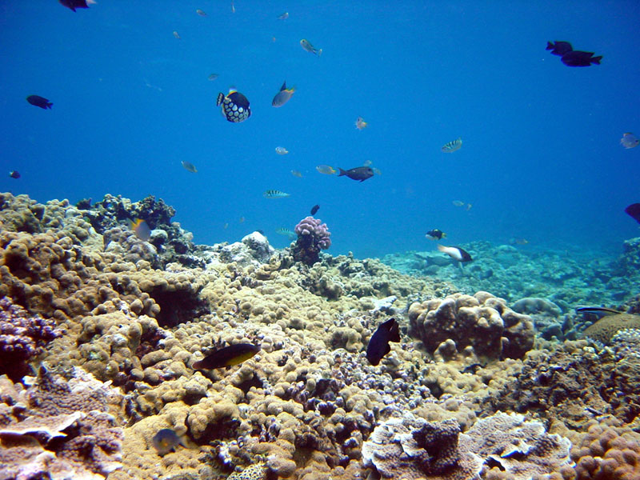
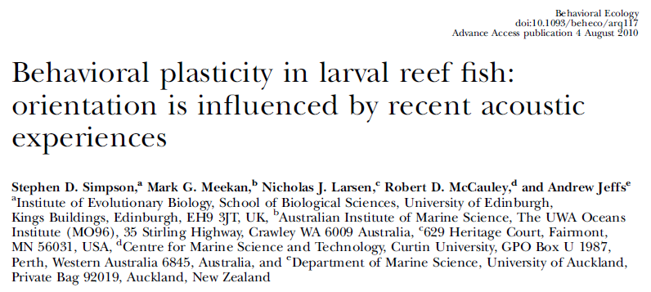
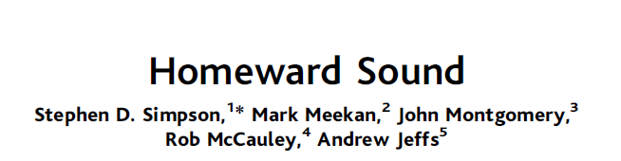

Ambient Underwater Sound Studies
Ambient underwater sound may act as a long distance orientation cue as well as a settlement cue
    Jeffs et al., 2003; 2005; Simpson et al., 2005; Radford et al., 2007; Stanley et al., 2010
Notes:
There have been a number of experimental studies which have concluded that ambient underwater sound emanating from coastal habitats may act as a long distance orientation cues for presettlement organisms looking for a habitat in which to settle.
CLICK
It is possible that the habitat-related differences in underwater sound that i have just discussed are being used to remotely guide the movement of coastal organisms in relation to these habitats.
These studies show that underwater acoustic cues may play a significant role in the recruitment processes of many important coastal species.
However, previously the role of underwater sound as a settlement and metamorphosis cue has not been as thoroughly investigated

Slide 11
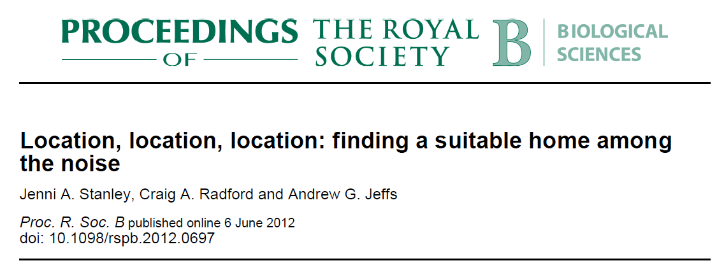
Induction of settlement in crab megalopae by different habitat sound signatures
Aim:
  Investigate the influence that sound signatures from different habitat types have on triggering settlement behaviour and/or shortening TTM
Notes:
- Therefore the aim of this research was to investigate the influence that sounds emanating from different habitats types have on triggering settlement behaviour and/or shortening TTM in common coral reef crab larvae
This study was conducted using both laboratory and field based experiments to eliminates the suggestion of any potential artefacts created in the laboratory

Slide 12
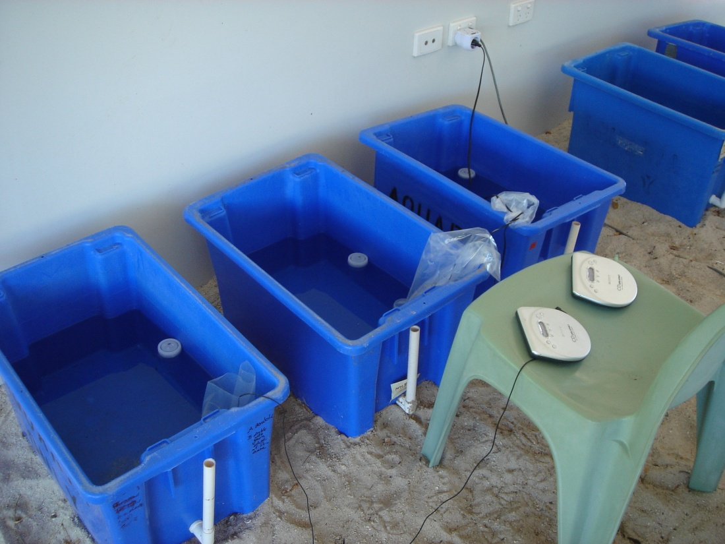
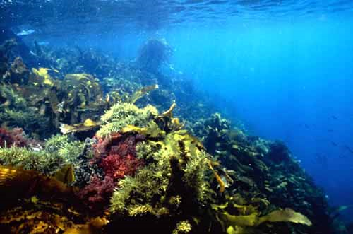
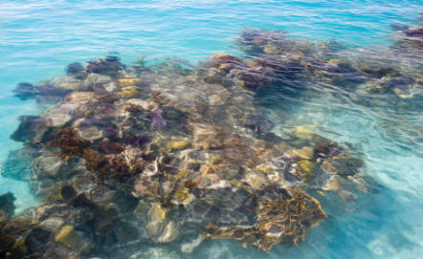
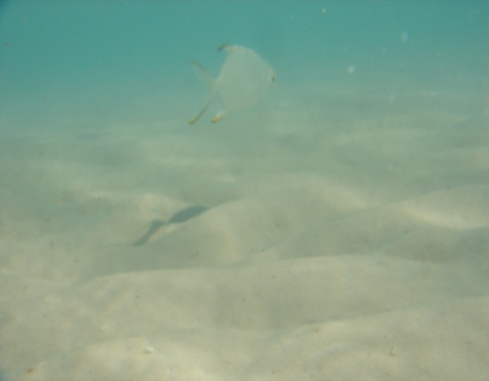
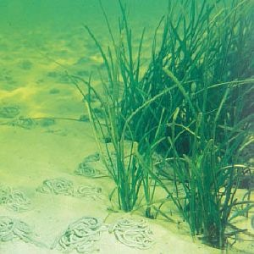
Methods - Laboratory Based Experiments
Four habitat treatments: distinct acoustically and biologically
    Continuous frontal fringing coral reef
    Isolated back reef habitat interrupted with areas of sand and coral rubble
    Sandy bottomed lagoon
    Silent (control)
Notes:
For the lab experiments all treatments had a loudspeaker submerged in the water bath the sound replicates only had a continuous 4min looped track of recorded reef sound playing.
megalopae were observed every 6 hours where counts were made of metamorphosed individuals
CLICK
There were four treatments, each a distinct habitat type both acoustically and biologically and represented a spectrum of suitability as adult habitats. Recording were played back at natural ambient intensities during all experiments

Slide 13
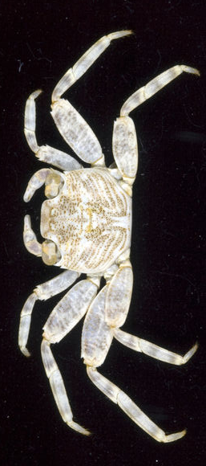
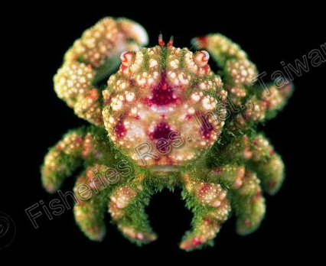
Results – Laboratory-based experiments
Grapsus
tenuicrustatus
30/84
36/108
66/120
66/120
Reduction of 47%
Percentage metamorphosed
48/102
48/114
60/138
72/138
Reduction of 33%
Cymo
andreossyi
Time (h)
Notes:
-Discuss graphs – Grapsus then Cymo
post-hoc tests showed a statistical significance between all but and lagoon and silent
-overall a 47% and 33% decrease in median TTM between the fastest and slowest treatment in these species

Slide 14
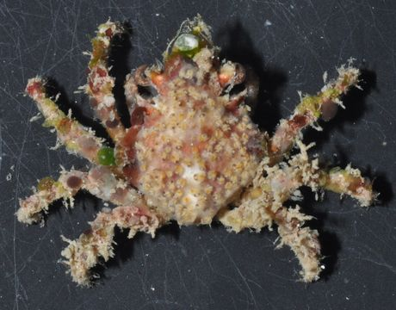
Results – Laboratory-based experiments
Schizophrys aspera
24/48
24/60
42/78
42/84
Reduction of 33%
Percentage metamorphosed
Time (h)
Notes:
-Schizophrys showed similar responses to the other two species Discuss graphs – post-hoc tests again showed a statistical significance between all but lagoon and silent
-overall a 33% decrease in median TTM between the fastest and slowest treatment for this species
- Across the 3 species tested in the laboratory-based experiments, megalopae metamorphosed significantly faster among the reef sound treatments than the silent, with the optimal reef habitat having the fastest TTM

Slide 15
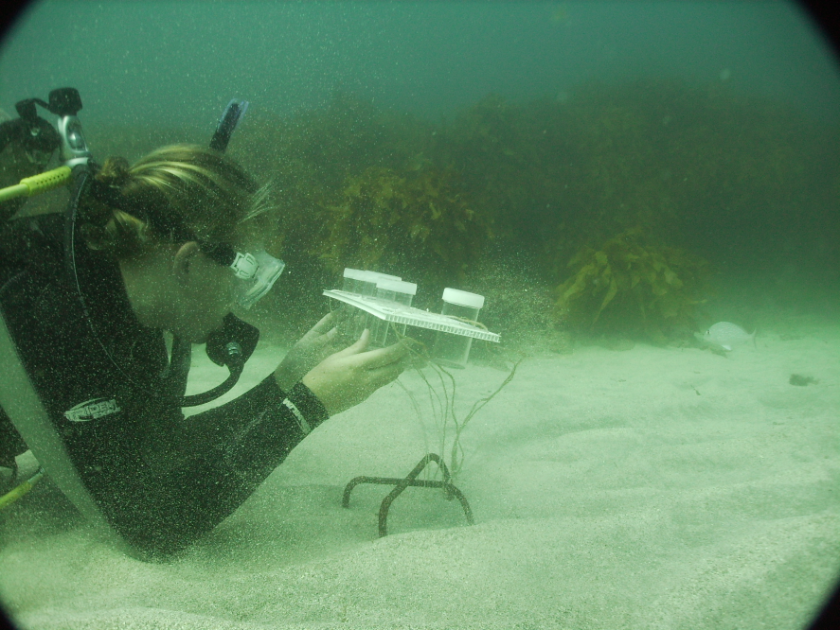
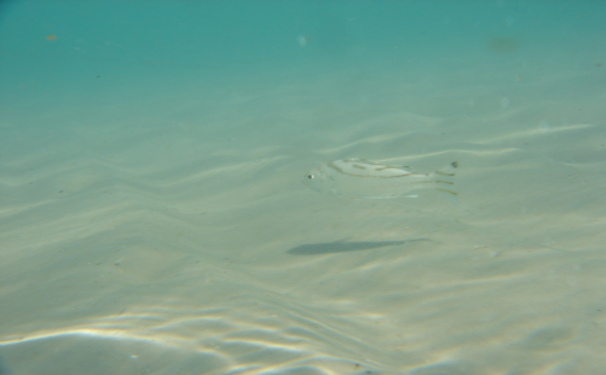
Methods - Field Based Experiments
Two Habitat treatments: distinct
acoustically and biologically
    Isolated back reef habitat interrupted with areas of sand and coral rubble
    Sandy bottomed lagoon
Notes:
In the field experiments each habitat type had three replicates which were tethered 40 cm from the seafloor, at reef sites these were held no greater than 2 meter from the reef. Here megalopae were observed 8am and 6pm
CLICK
-Two sites were used in the field-based experiments, Horseshoe Reef, fairly dense isolated patch reef with many invertebrate and fish species
CLICK
and Mangrove Beach lagoon, a lagoon furthest away from any nearby reefs. Unfortunately, a frontal fringing reef could not be included due to weather conditions.

Slide 16
Results – Field-based experiments
Grapsus
tenuicrustatus
48/87
48/159
Reduction of 32%
Percentage metamorphosed
48/87
48/144
Reduction of 29%
Cymo
andreossyi
Time (h)
Notes:
Discuss graphs grapsus and cymo
overall a 32 and 29% decrease in median TTM between the fastest and slowest treatment for these species

Slide 17
Results – Field-based experiments
Schizophrys aspera
48/87
48/159
Reduction of 25%
Percentage metamorphosed
Time (h)
Notes:
Discuss graph
overall a 25% decrease in median TTM between the fastest and slowest treatment
In the field based experiments for the three species, again megalopae metamorphosed significantly faster among the sound treatments that matched their optimal adult habitat.

Slide 18
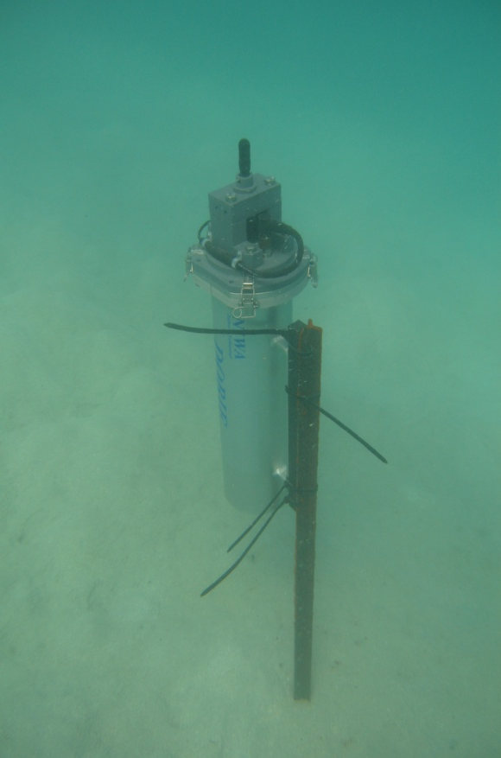
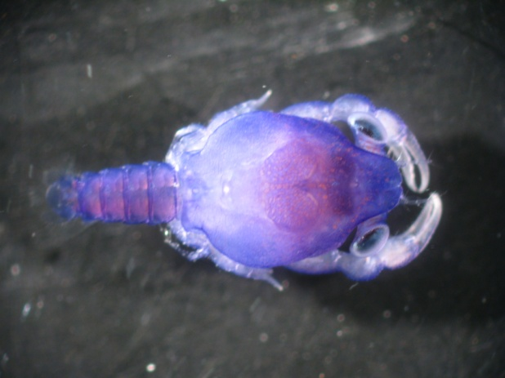
Conclusions
Similar results in both tropical and temperate species
Clear preference for optimal adult habitat type
Ability to discriminate habitat by sound signatures
The acoustic cue mediates an endogenous physiological development process
Remote habitat identification using acoustic cues
Integration of all the available cues now needs to be investigated
Notes:
-The results of the current study provides clear evidence that differences in ambient underwater sound influences the settlement and metamorphosis rates of several brachyuran megalopae from tropical waters. Similar results have also been observed in species from temperate waters.
Collectively the existing evidence suggests that ambient underwater sound effects the distribution and orientation of a number of settlement stage reef organisms.
The replayed acoustic cue in these experiments not only influenced the behaviour of the megalopae but also appears to mediate an endogenous physiological development process that expedites metamorphosis.
Therefore if these stages are adjusting their settlement responses to varying spectral and temporal characteristics then underwater sound is of major importance in structuring the spatial settlement and subsequent recruitment in reef organisms.
- Although single cues are often researched and discussed separately, however the effective use of multiple cues is common in many animals that are attempting to get from one place to another and this is no exception with reef dwelling organisms.
The importance and use of each will vary with spatial scale, and integration of the multitude of available cues now needs to be investigated.

Slide 19
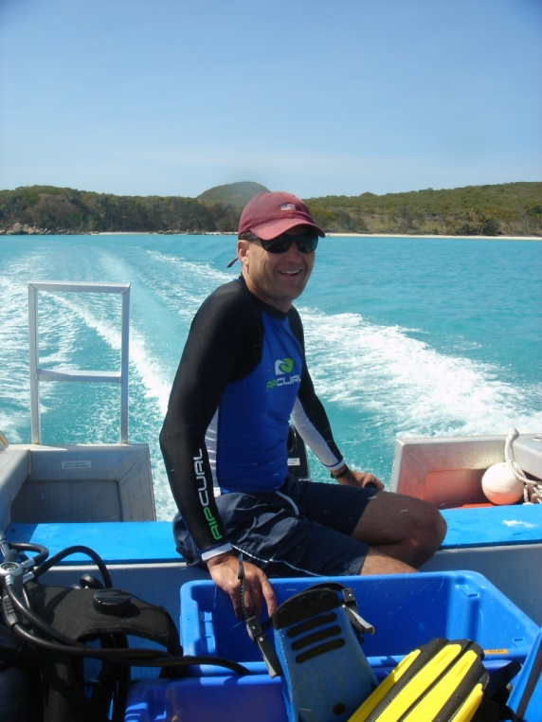


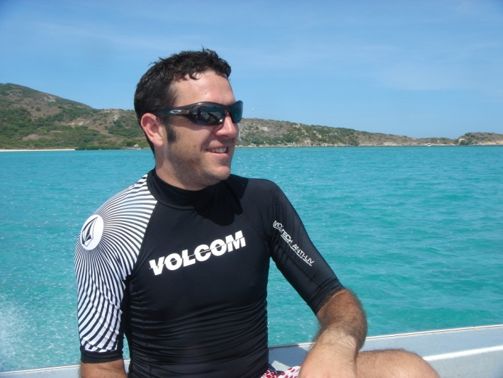
Acknowledgements
Thanks To:
Associate Professor Andrew Jeffs
Dr Craig Radford
NZMSS Student Research Funding
Leigh Marine Laboratory Staff and students
Lizard Island Research Station Staff and visiting students

